Slide 1
html
The world wide web

Slide 2
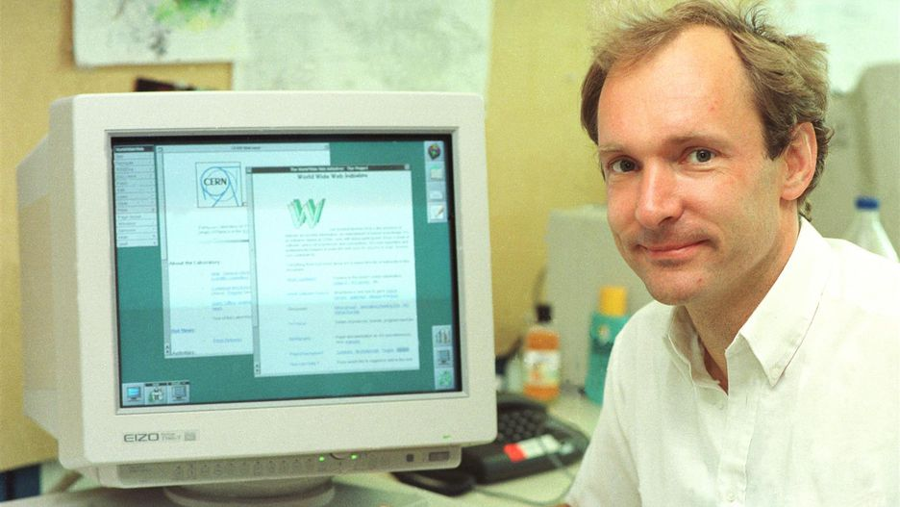
History – part 1
Tim Berners-Lee

Slide 3
1980s the Internet got domain names and DNS
SGML Standard Generalized Mark-up Language
An internationally agreed upon method for marking up text into structural units such as paragraphs, headings, list items, etc
language was independent of the viewing software
Pairs of tags, title, H1 – H6, OL, UL, LI, P,
HTML
Anchor with HREF
www.example.com – address machines on the ‘web’

Slide 4
History
Text based
Very limited number of tags
Easy to learn and edit
Browser only displayed text
1993 - a college student named Marc Andreessen added <img> to his Mosaic browser
1993 – Lynx 2.0a

Slide 5
Forms
<form>
action – URL
Method – get or post

Slide 6
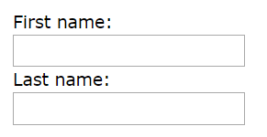
<form> First name:<br> <input type="text" name="firstname"><br> Last name:<br> <input type="text" name="lastname"> </form>

Slide 7
<form action="https://www.w3schools.com/action_page.php" method="get">
<form action="https://www.w3schools.com/action_page.php" method="post">
GET:
https://www.w3schools.com/action_page.php?firstname=Mickey&lastname=Mouse

Slide 8
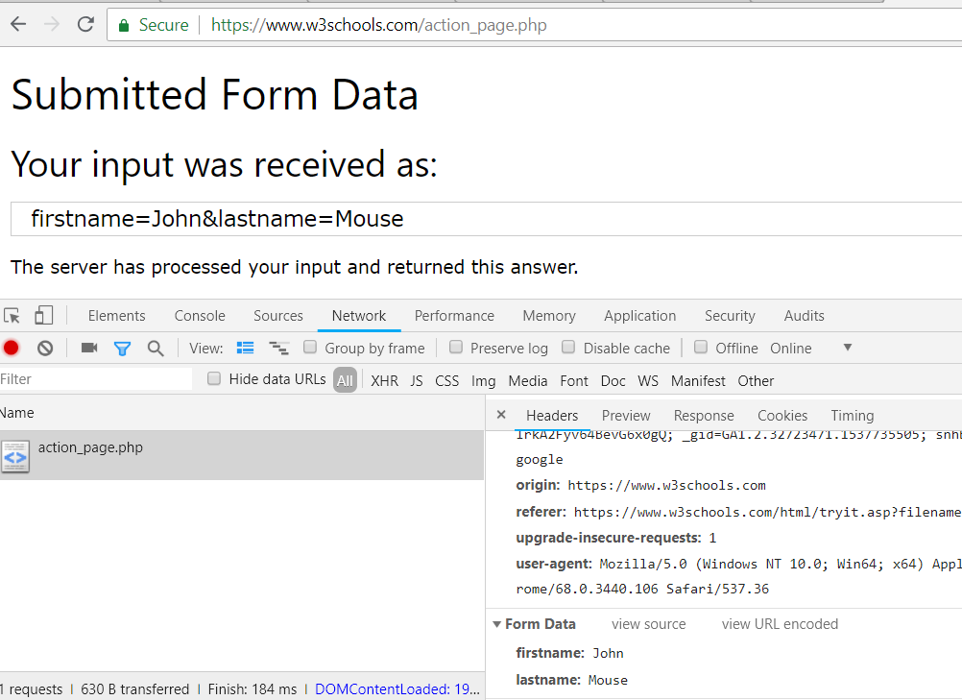

Slide 9
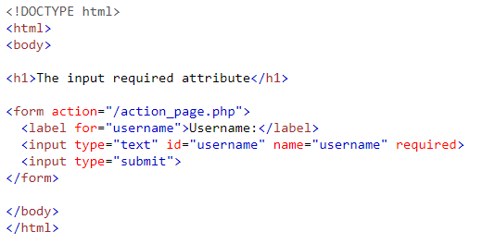
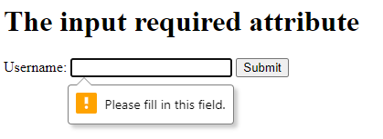
required
Chrome and Firefox do NOT allow the error bubble to be styled
https://stackoverflow.com/questions/20892240/change-css-style-html5-form-required-attribute-required-message

Slide 10
Task 1
See worksheet “07 – Forms”

Slide 11
css
Cascading style sheets
Apply styles to elements
An element is a tag
A style is anything visual – colour, font, size, borders etc

Slide 12
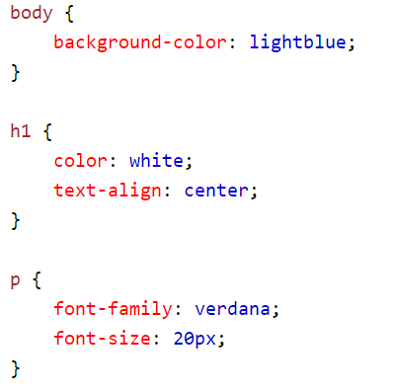

Slide 13
Css
Selector
Property : Value ;

Slide 14
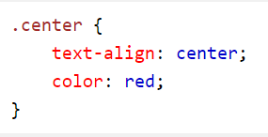
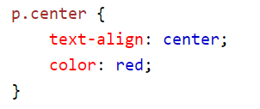

Slide 15
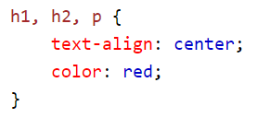

Slide 16
KNOW html + css?
Carry on with HTML and css
If you finish:
Code a beautiful page
Pull in bootstrap

